Slide 1

Maison Roberts
Mayday Electronics

Slide 2

My Business Idea
Location
A shop in a town
Opening Times
10AM to 5pm
Target Market
People who need help fixing a repairing there devices and a place to buy and sell your electronics
Market Research Findings
I found that the target market for fixing electronics are people who have little to no experience in repair and people who want to purchase new electronics and give them a new home
Resources needed
I need: Games, Consoles, Accessories , Tools and parts and Phones
Notes:
Location: The location is good as a town is a busy place and where people go to buy and sell and repair electronics meaning it would catch peoples eye and people who need a quick screen repair or need to buy a new phone can come in and grab a quick repair or new phone
Opening Times: These opening times would be the best time to open as 10am to 2PM is peak time for people to visit a town and get errands ran and will allow for a massive inflow of customers
Target Market: This is the types of people who would visiting and looking at the store and buying items which is people who needs repairs or new or quick selling there items

Slide 3

Business Aims and Objectives
Our aims and objectives are: Firstly to make profit
Secondly to provide the community with cheap electronics and repairs
Our aim is to expand more stores into more towns and busy areas which will allow us to gain more profit and provide repairs and electronics to more people
Notes:
I chose these aims as it will allow us to expand the business and it is the reason we are running the business

Slide 4

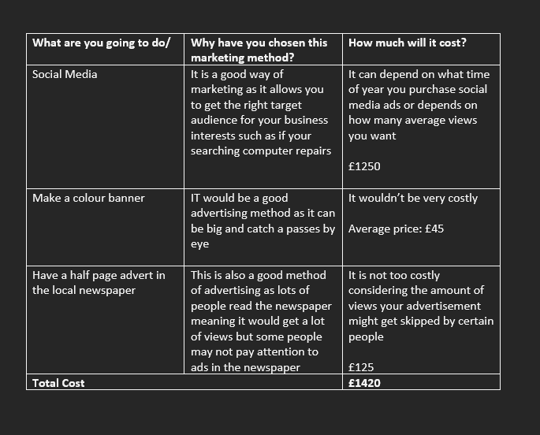
Advertising and Promotion
Notes:
What are your advertising methods?
Any advantages?

Slide 5
Finance
A | Number of units in calculation
B | Cost per Unit | 65
C | Price per unit | £159
D | Profit Margin (£) | £39
E | Profit Margin (%) | 24.53%

Slide 6

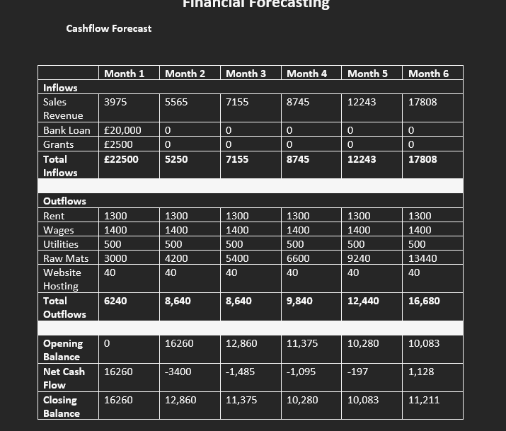
Cashflow Statement
Notes:
Explain your cash flow statement
You can add some breakeven information as well

Slide 7

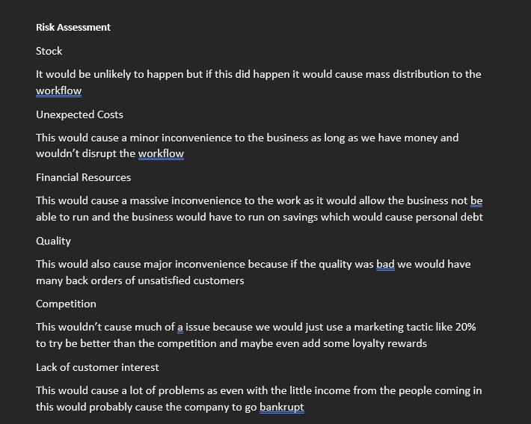
Risk Assessment
Notes:
What risks have you identified and what plan do you have to solve them?
E.g. poor promotions or advertising, price too high and so no sales

Slide 8

Any questions?
Notes:
State why yu think the enterprise ill be a success and ask for any questions from th4e audience

